Slide 1
BACKGROUND VERIFICATION
Team Members:
Prakhar
Janaki
Surenderan
Vishal
Sammanitha
Mentor :Vidhya Selvaraj
Notes:
Add instructor notes here.

Slide 2
OBJECTIVES
Project Understanding
Approach used
Project Execution
Modules
Learning
Best Practices
Opportunity for improvement
Notes:
Add instructor notes here.

Slide 3
PROJECT UNDERSTANDING
The main objective of this project is to design and develop an Background Verification System.
Background Verification System is used to upload the documents of an employee and to view status of the uploaded documents.
The Background Verification System is used to set the status of the documents and to search the employee documents through employee Id and employee Name.

Slide 4
High Level Design Diagram
Controller
Microservice
User Interface
Controller
Service
Dao
Database

Slide 5
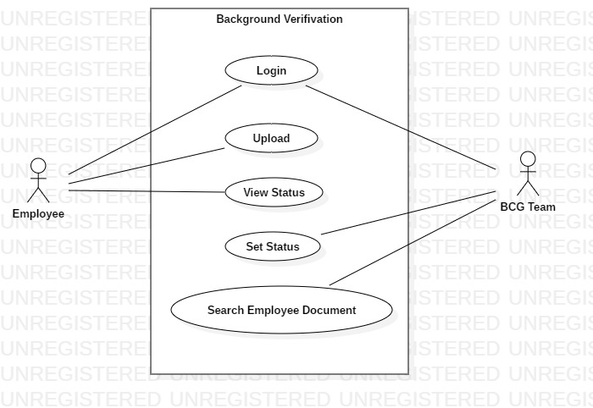
USE CASE DIAGRAM

Slide 6
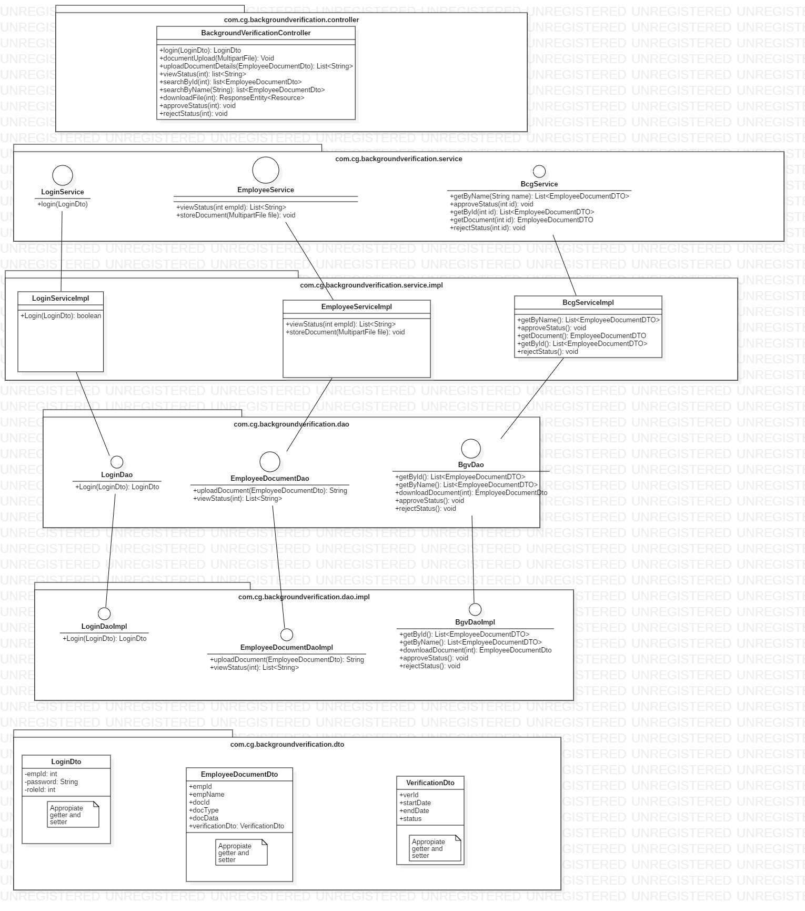
CLASS DIAGRAM

Slide 7
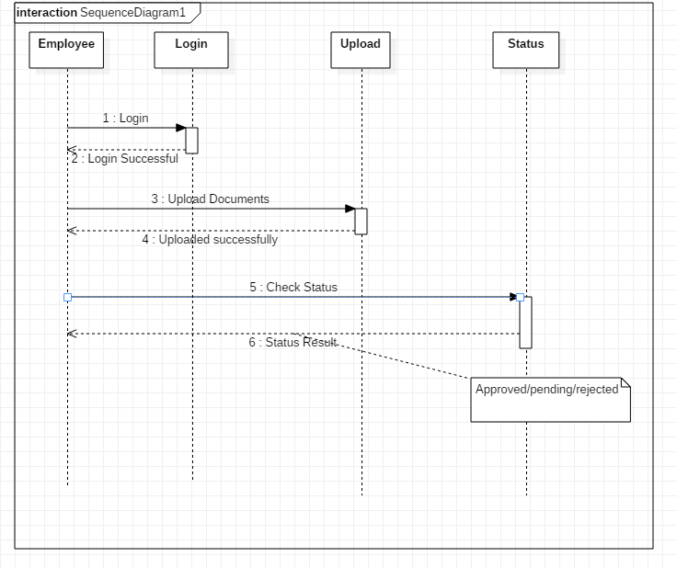
SEQUENCE DIAGRAM FOR EMPLOYEE

Slide 8
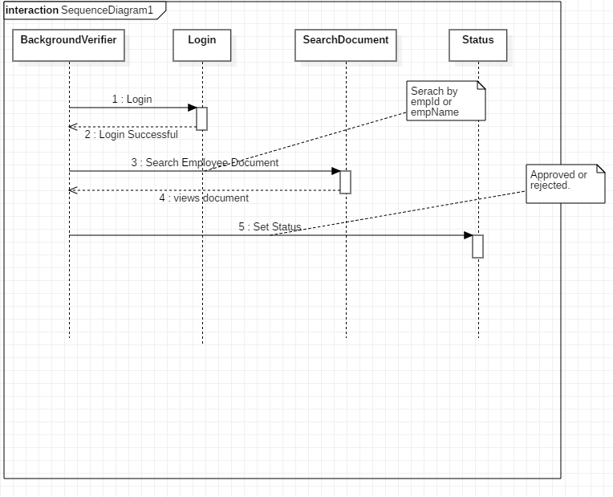
SEQUENCE DIAGRAM FOR BGV TEAM

Slide 9
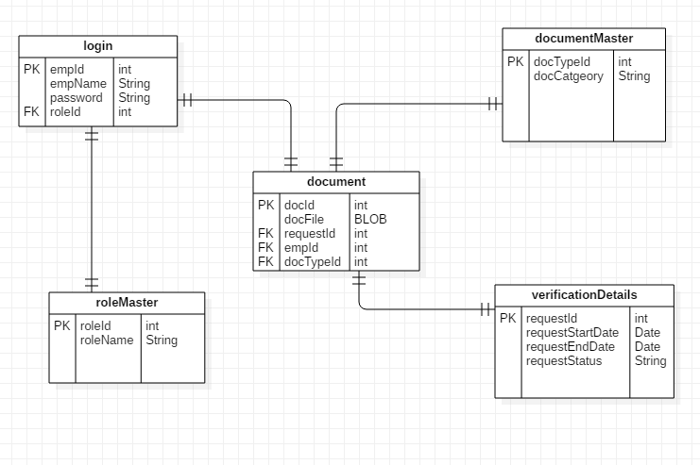
ER DIAGRAM

Slide 10
APPROACH USED
    Front End & Web Components:–
      Angular 8
    Business Logic Components and Services :-
      -Spring Boot
      -Microservices
    Databases:-
      -Oracle SQL
      -MySQL(cloud)

Slide 11
PROJECT EXECUTION
Login Module
Employee Module
BGV (background verification team) Module

Slide 12
LOGIN MODULE
Login:
Employee can login into the portal through his/her login credentials.
Background Verification team can also login into the portal.

Slide 13
EMPLOYEE MODULE
Employee:
Login
Upload documents into his/her portal
View status of the uploaded documents

Slide 14
BGV TEAM MODULE
BGV Module:
Login
Set status of the employee.
Search by Employee id and Employee name

Slide 15
LOGIN MODULE
Employee Module:
Login module is common for both employee and
BGV team.
Take login credentials from the employee
If login credentials are wrong, will give error message .
If login is successful, will navigate to employee portal.

Slide 16
LOGIN MODULE
BGV Module:
Take login credentials from the BGV team.
If login credentials are wrong, will give error message .
If login is successful, will navigate to BGV team portal.

Slide 17
EMPLOYEE MODULE
Employee can upload educational documents and address verification documents in the portal.
Employee can see the status of the uploaded documents through his/her login credentials in the portal.
Employee can re-upload the documents after the verification of the documents from the background verification team.

Slide 18
BACKGROUND VERIFICATION MODULES
Background verification team can verify all the documents uploaded by the employee in the BGV portal.
The BGV team can accept or reject the documents if the uploaded documents is not clear or the size of the document is large.
Search the documents through the employee Id and employee name.

Slide 19
LEARNING
We have implemented the Background Verification project, using Spring boot framework with JPA and Angular.
We have learned to work as a team.
Time Management and division of work.
Supporting team members in the work.

Slide 20
BEST PRACTICES
Followed placing comments in appropriate places
Followed naming conventions.
Followed proper indentation.

Slide 21
OPPORTUNITY FOR IMPROVEMENT
The following features can be further implemented to improve the project:-
-Notification of document status to employee through messages.

Slide 22
MVP PLAN
MVP | Product | Start Date | End Date | Remarks
1 | Login Authentication | 7/8/2019 | 7/8/2019
2 | Employee Portal | 8/8/2019 | 10/8/2019
3 | BVG Portal | 10/8/2019 | 12/8/2019
4 | Deployment | 13/8/2019 | 14/8/2019

Slide 23


